Slide 1
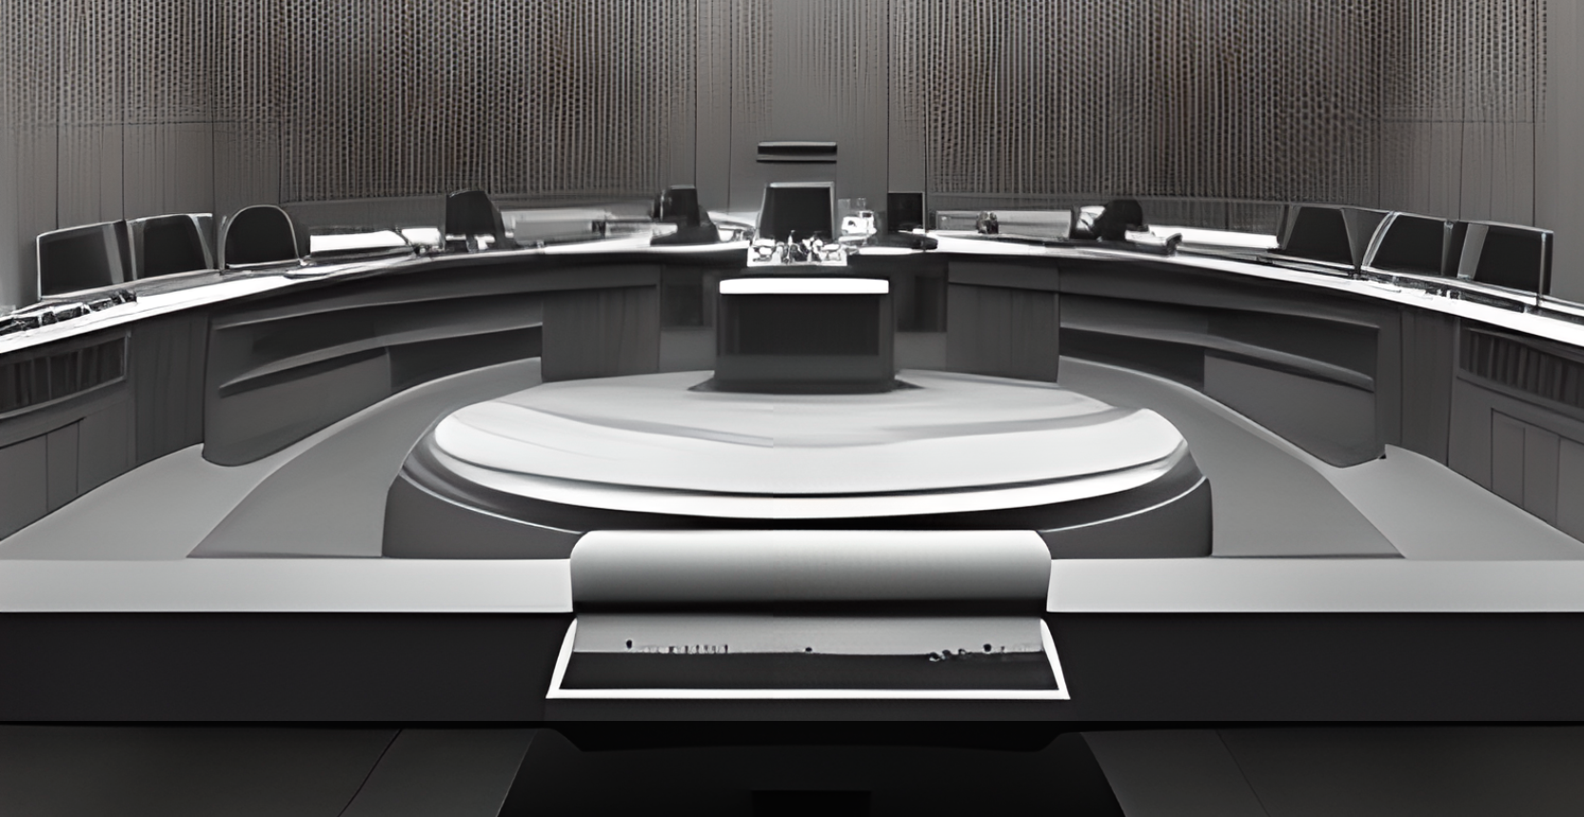
Image Moderation System
Project By: Boutros M. Tawaifi
Supervised By: Dr.Feirouz Shakkour

Slide 2
Introduction
Images are a key component of the online content in different domains
User generated content isn’t always safe so image moderation is important
There is a need for effective and accurate image classification
It isn’t efficient to rely on manual humans classification
We need automated systems to take care of the bulk of work
Fact: Facebook has over 300 Million images uploaded each day

Slide 3


Project Overview
Develop an image moderation system for classifying and moderating user-generated content
Integrate advanced computer vision model for accurate image recognition
Create an API for user-system interaction with the model
+
C.V. Model

Slide 4
Project Goals
Choosing the right classification model that allows for cost-effectiveness
Integrate the model in a flexible interface (REST API) so that the user can interact with it
Model evaluation

Slide 5
Choosing The Right Model

Slide 6
Image Classification Techniques
Traditional Image Classification Algorithms
Early image classification relied on (k-NN), (SVM), Decision Trees.
Manual feature engineering was required.
Emergence of Deep Learning and Convolutional Neural Networks (CNNs)
CNNs automatically learn discriminative features and complex patterns.
Models like LeNet, AlexNet, VGGNet, GoogLeNet, and ResNet introduced advanced strategies to improve performance.

Slide 7
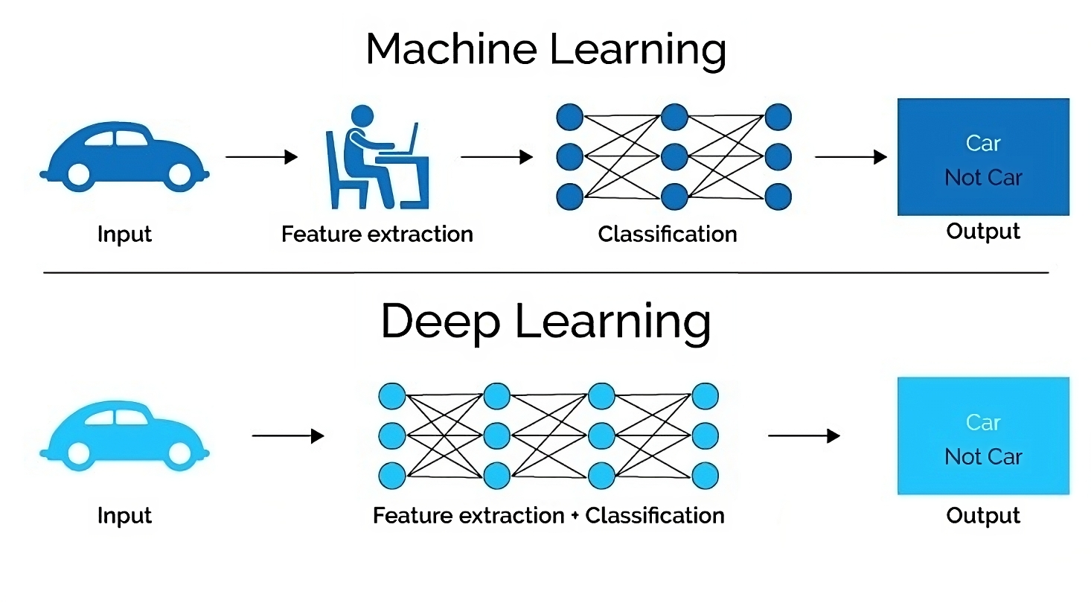

Slide 9

CNNs group several pixels together (an example 3×3 pixel like in the image above) so they can understand a temporal pattern.
As the data flows through the layers of the network, lower-level layers capture basic features such as edges and textures, while higher-level layers combine these features to learn more complex patterns and concepts.

Slide 10
Understanding Transformer Architecture
Introduction to Transformers
Transformers are a type of model architecture used in natural language processing.
They were introduced in the seminal paper "Attention is All You Need” in 2017.
ViT (Vision Transformer) is used for computer vision

Slide 11
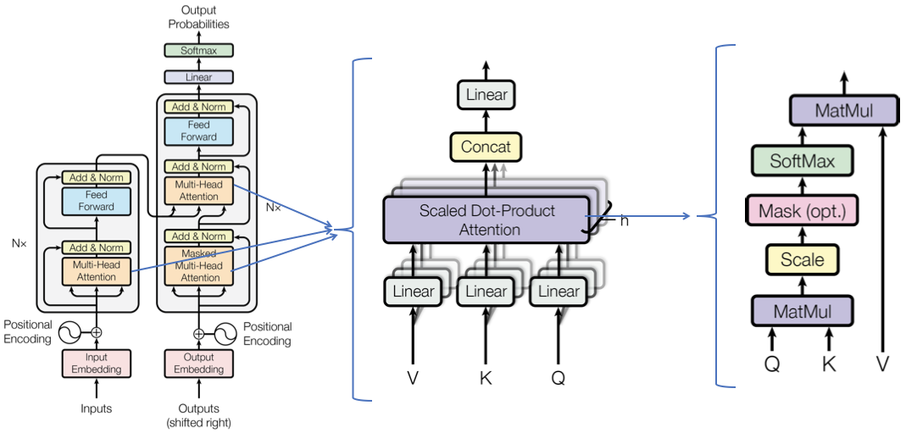
Key Components of Transformers
The transformer model consists of an encoder and a decoder. Each of these components is made up of multiple layers of self-attention and point-wise feed-forward networks.

Slide 12
Attention Mechanism
Used to weigh the influence of different input parts in the output.
Uses "Scaled Dot-Product Attention”, allowing the transform to understand a word based on the surrounding context.
Positional Encoding
Does not inherently understand the sequence in the data (unlike RNNs or LSTMs)
Therefore they use positional encoding to capture the order of the sequence.

Slide 13
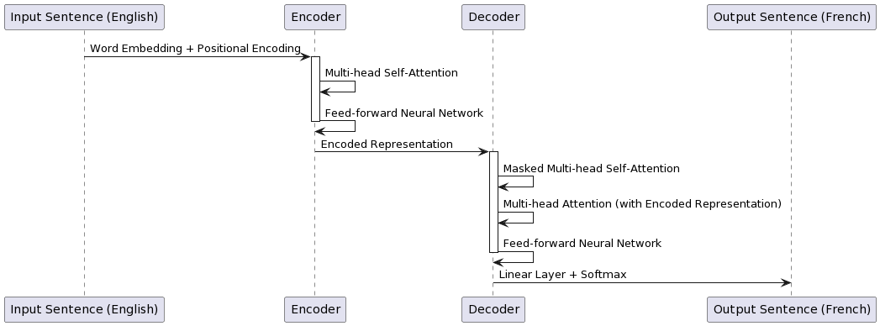

Slide 14
CLIP Model by OpenAI
Introduction to the CLIP (Contrastive Language-Image Pretraining) model
Ability to understand visual and textual content
Advantages in image moderation and classification (Zero Shot Prediction/Transfer Learning)
Trained on conceptual captions dataset

Slide 15
The Conceptual Captions dataset
The Conceptual Captions dataset is a large-scale dataset of image captions that was created by Google AI in 2018.
It contains over 3 million images, each paired with an ENGLISH natural-language caption.
The captions are harvested from the Alt-text HTML. attribute associated with web images.
Example:
Image: A woman is sitting on a bench in a park, reading a book.
Caption: A woman enjoys a leisurely afternoon in the park, reading a book.
Image: A group of people are gathered around a table, eating dinner.
Caption: A family enjoys a delicious meal together.

Slide 16
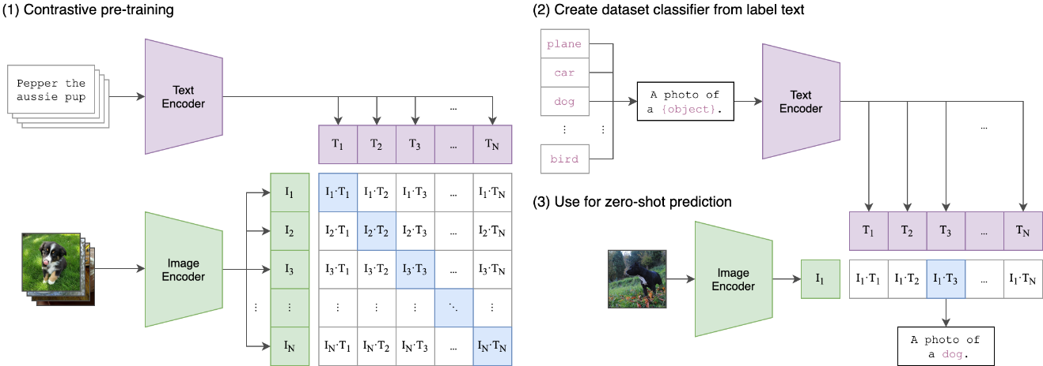

Slide 17
Top-5 Accuracy | Top-1 Accuracy | Model
96.0٪ | 82.5٪ | ViT-B16
93.6٪ | 78.3٪ | ResNet-50
Vision Transformer
CNN
Model | Top-1 Accuracy | Top-5 Accuracy | Computational cost of training | Computational cost of inference | Number of parameters | Source | Testing Dataset | RAM required
openai/clip-vit-base-patch32 | 86.1% | 97.4% | 1 week on 4 TPUv4 Pods | 100 ms | 838M | Hugging Face | Conceptual Captions | 838 MB
openai/clip-vit-large-patch14 | 88.8% | 99.0% | 2 weeks on 4 TPUv4 Pods | 150 ms | 3.4B | Hugging Face | Conceptual Captions | 3.4 GB

Slide 18
Transformers in Image Moderation: Pros and Cons
Advantages
Long-range dependencies capture
Robustness to noise compared to traditional image classification models like CNNs.
Generalization of learning to new images
Disadvantages
Computational cost
Accuracy in object detection

Slide 19
Integrate the model in a flexible interface (REST API)
so that the user can interact with it

Slide 20
Technologies and System Architecture
Python
FastAPI
PyTorch
Transformers
Pydantic
Uvicorn

Slide 21
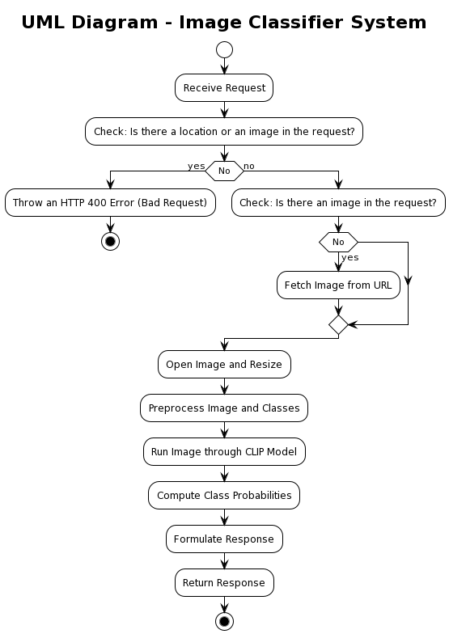
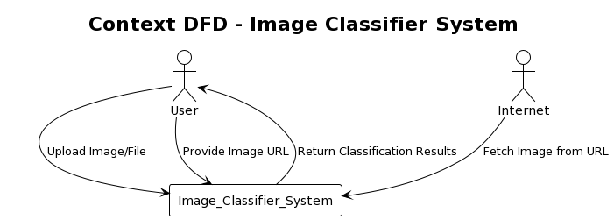
HTTP Formdata Request Contains
Image(Bytes), Location(URL), LABELS(Classes)
Response is the most likely image prediction between the input labels
NO
YES
YES
NO
+ Classes
+ Classes

Slide 22
System Demonstration
Step-by-step demonstration of the image moderation system
User interaction, image processing, classification and moderation, user feedback, result presentation

Slide 23
Performance Evaluation In Image Moderation
Labels That were used are: NSFW, SFW. using openai/clip-vit-base-patch32 on I5-1135G7
NSFW (5,422 Images) -> Error are SFW
SFW (444 Images) -> Error are NSFW
Metric | Result
Model accuracy | 96.62%
Average time per image | 0.10913 seconds
Memory used | 470.63 MB
Metric | Result
Model accuracy | 77.25%
Average time per image | 0.10956 seconds
Memory used | 674.94 MB

Slide 24
Future Enhancements
Integration with other advanced models or algorithms (User can pick the model he wants).
Providing the ability for moderation.
Expanding system's capabilities for new categories or classifications (Fine Tuning/ Training).
Batch processing and Scalability.
Video classification.
integration with other services (web Hooks).
real-time classification.

Slide 25
Conclusion
Importance of image moderation in the digital era
Contributions and achievements of the project in developing an adaptable and cost-effective system
Enhancing safety and appropriateness in the digital environment

Slide 26
References
LeCun, Y., Bottou, L., Bengio, Y., & Haffner, P. (1998). Gradient-based learning applied to document recognition.
Krizhevsky, A., Sutskever, I., & Hinton, G. E. (2012). ImageNet classification with deep convolutional neural networks. Advances in neural information processing systems.
Simonyan, K., & Zisserman, A. (2014). Very deep convolutional networks for large-scale image recognition.
Szegedy, C., Liu, W., Jia, Y., Sermanet, P., Reed, S., Anguelov, D., ... & Rabinovich, A. (2015). Going deeper with convolutions.
He, K., Zhang, X., Ren, S., & Sun, J. (2016). Deep residual learning for image recognition.
Vaswani, A., et al. (2017). Attention is all you need. In Advances in neural information processing systems.
Chen, T., Isola, P., & Zhu, J. Y. (2021). DeiT: Data-efficient image transformers.
Dosovitskiy, A., et al. (2020). An image is worth 16x16 words: Transformers for image recognition at scale.
Radford, A., et al. (2020). Improving language understanding by generative pre-training.
Radford, Alec, Jeffrey Wu, Rewon Child, David Luan, Dario Amodei, and Ilya Sutskever. "Language models are unsupervised multitask learners." OpenAI Blog(2021).
Google AI. "Imagen: A Text-to-Image Diffusion Model with High Fidelity and Control." Google AI Blog (2022).
Dosovitskiy, Alexey, Lucas Beyer, Georg Heigold, Lucas Mnih, Andrew Brock, Aäron van den Oord, et al. "An image transformer." (2020).
Radford, Alec, et al. "Learning transferable visual models from natural language supervision." European Conference on Computer Vision (ECCV). 2020.
https://fastapi.tiangolo.com/benchmarks/

Slide 27
Acknowledgments
I am grateful to my college professors for their guidance and support during my academic journey. Their expertise and dedication have greatly influenced my growth and learning.
Thank you for sharing your knowledge and for being exceptional mentors.

